Slide 1
AB 705 Implementation Plan
Presented by LATTC English Department
Notes:
Hello Im Jennifer Ortiz, English Department Chair for those who may not be aware I’m not Jan -Im looking forward to my new charge
Then Sally, Then Cindy and out workgroup has been working diligently for the past year in creating a plan that will ensure we are in compliance with AB 705 and a strategy where we work collectively as a department and as a campus. As we’ve conducted our research we also learned that AB 705 is grounded on students rights, but also forces us to address the fact the remedial courses disportionately impact Black and Latinx students. AB 705 is an opportunity for us to implement changes which will be racially equitable to students of color.

Slide 2
Agenda
What we know about AB 705
This is what we’re going to do: Strategy
Making English easy
Check out our handout on the English Department’s timeline and roll out
And we’ll take your questions at the end
http://college.lattc.edu/catalog/important-policies/
Notes:
Our presentation will be broken up into several parts. The first we will share what we currently know about AB 705., Second our strategy and how we plan to capitalize on our current structure and the PACTS model, then how we are changing the English sequence to align with equity goals, we have a website with a timeline you can take a look at, and at the end we will open it up for questions

Slide 3
AB 705
AB 705 requires community college districts to maximize the probability that a student will enter and complete transfer-level coursework in math and English within a one-year timeframe by utilizing assessment measures that include high school performance to achieve this goal.
What is the intent of AB 705?
Assessment instruments and placement policies have serious implications for equity, since students of color are more likely to be placed into remedial courses; and, students placed into remediation are much less likely to reach their educational goals.
The goal of AB 705 is to ensure that students are not placed into remedial courses that may delay or deter their educational progress unless evidence suggests they are highly unlikely to succeed in the college-level course.
Community colleges are prohibited from requiring students to take a prerequisite course unless they are highly unlikely to succeed in a higher-level course without it, pursuant to Section 55003 of Title 5 of the California Code of Regulations, but this policy is not followed in practice.
Colleges are required to use multiple measures in determining course placement, pursuant to Section 55522 of Title 5 of the California Code of Regulations, but Title 5 of the California Code of Regulations does not provide enough guidance in the use of multiple measures to ensure that students are not excluded from courses in which they can be successful.
Evidence suggests that when used as the primary criterion for placement, assessment tests tend to under-place students; and, a student’s high school performance is a much stronger predictor of success in transfer-level courses than standardized placement tests.
Notes:
So here is what we know about the bill thus far: AB 705 requires community college districts to maximize the probability that a student will enter and complete transfer-level coursework in math and English within a one-year time frame. “Maximizing” means that students will actually begin at transfer-level, and a one-year timeframe is described as two consecutive semesters. So if a student were to take an English course during Summer Session #1 and then another course during Summer Session #2, that would count as one year.
AB 705 also applies to students who do not intend to transfer. Students whose goal it is to earn a certificate or A.A degree must also complete whatever math & English requirements are necessary within a one-year time frame. So for one of the A.A degrees, students need only complete English 28; under AB 705, this course must be completed within one year.
When we look at the intentions behinds the bill, we can see that the bill is an equity-minded approach to reforming course sequences for Math & English.
Assessment instruments and placement policies typically lead to students of color being placed into remedial courses; students placed into remediation are much less likely to complete their educational goals.
AB 705 aims to ensure that students do not get bogged down in a remedial course sequence that will delay or deter their educational progress unless evidence suggests that they are highly unlikely to succeed in a college-level course
community colleges are not allowed to require that students take a prerequisite course unless they are highly unlikely to to succeed in a college course without it
Community colleges are now required to use multiple measures in determining course placement
Evidence suggests that assessment tests tend to under-place students; and, a student’s high school performance is actually a much stronger predictor for success in a transfer-level course

Slide 4
How do we use our current structures at LATTC to support AB 705 and student success?
Student Experience
Faculty Support
Student Academic Support
Coordination with Bridges/Student Services-
-Embedding practices with PACTS Tier 1
-Intentional Collaboration and Training with Counseling
-Across campus, discipline coordination DSPS, Vet Center
-Coordination with Navigators
-Create outreach materials
-Faculty Liason with LA Promise
-AB 705 website
-Developing Materials / Scripts/ Common questions
-ASO Presentation for AB 705
Institutionalizing Faculty Development-
-Embedding practices with PACTS Tier 2
-Reading Apprenticeship
-Equity minded practices and instruction
-Trainings Fundamentals of Knowledge
-Affective Domain, Habits of Mind practices
- Syllabi evaluation and design via equity lens
-CANVAS administrator and facilitation
-Just in time remediation
-Acceleration
Coordination with Academic Connections-
-Intentional Collaboration and Training with Writing Center and Basic Skills Reading and Writing Instruction
-Observation protocol for Tutors and Basic Skills reading and writing instruction
-Pedagogical Training and Best Practices
-Faculty training on how to work with Tutoring Services
Notes:
Because AB705 offers an opportunity to reevaluate multiple aspects of our campus practices and to shrink equity gaps, we have established a timeline and recommendations that support all campus stakeholders in making changes that comply with the law. Our AB705 workgroup has considered how to best strengthen and support our partnerships across campus and across disciplines so that the campus can absorb the changes into our culture. For the sake of time I will give a brief overview of the 3 buckets, so to speak, that we have used to divide up the work.
Firstly, we plan to ensure the student experience is coherent and that we are all speaking the same language, so we will be working with the onboarding and resource programs to share information on how our departmental changes affect their work with students.
Secondly, we anticipate faculty across the disciplines may want to access the resources we’ve gathered over the past year or so and share in the innovative pedagogies with which we’ll be engaging our students in order to best strengthen reading and writing across disciplines. Our workgroup has attended multiple conferences over the last year and we’ve engaged and shared pedagogy with a variety of instructors and campus equity leaders who have been advocating for these changes for a while. As you can see here, meeting the demands of AB 705 calls for us as instructors to engage in pedagogy via an equity lens. Our ethos is that instead of viewing student writing from a deficit model, we have a chance to engage all students with meaningful material that befits their status as a college student and that involves some reevaluation of our teaching methods.
Thirdly, academic support will be a component of student success and we plan to strengthen our partnership with tutoring services to develop a scalable model for classroom support. As we offer additional academic support, it’s important that our peer educators have a clear understanding of our goals and methodology so we can provide intentional and effective support.
Finally, as we collaborate with our department and memorialize our strategy, campus partners can expect to hear from us in Fall and early Spring, but of course we are available as this work is in progress.
DO WE NEED TO INCLUDE TRAININGS OF NORMING - adjuncts make one FT resource person - course level committees (incentives- funded by BSI BSSOT stipend for organizers - stipend for all participants for $150 )-I’m not sure what this all means? S

Slide 5
Revised Sequence for AB705 Compliance
Current Model:
Under AB 705:
Remedial Sequence:
Students take
English 100
English 28
before moving onto English 101
English 100 only for students who self-select or have G.P.A below 1.9
English 28
We maximize the number of students who begin with English 101
Notes:
Before Cindy explains our planned course sequence, this slide gives an overview of the current course sequence and the suggested changes. As of now, students would potentially take 2 semesters of English before they clear prerequisites for transfer-level English (English 101). The traditional model for the last 20 years or so has consisted of adding more and more remedial classes, and success has been measured by success rates in those classes. However, the numbers of students reaching transfer level English from those classes is depressingly low.
As shown in the data D. Joof spoke of earlier that motivated the changes in the law, even if students are successful in the developmental class, the more classes they take to reach transfer level, the more likely they are to drop out along the way. The data shows that the more drop off points there are, the more students are likely to exit before reaching transfer level English, and as mentioned previously, this impacts students of color disproportionately.
Under AB705 students will enroll in English 100 or in one of two iterations of English 101. In compliance with the new law, most students will be eligible for English 101 which they will be able to take with or without concurrent support.
Cindy will now explain in more detail how students will be directed in the new sequence.

Slide 6
Pathway to Transfer-Level English
G.P.A, highest grade in last English course, and other factors will affect placement.
If High-School G.P.A is below 1.9
English 100
Or
Enhanced 101
If High School G.P.A is 2.0-2.6
Students can elect to enroll in Enhanced 101 or Stand-Alone 101
Questions?
See the English Department website:
http://college.lattc.edu/english/
Or email English faculty:
ORTIZJI@lattc.edu, Department Chair
cruzca2@lattc.edu,
sowtersv@lattc.edu
If High School G.P.A is 2.7 or above
English 101
Notes:
Here is what our course sequence will look like under AB 705:
Students with a g.p.a below 1.9 will either take English 100 or Enhanced 101 (students can self-select); the Enhanced 101 course is a traditional 101 course that has 2 hours of lab tacked on to it for additional support--this co-requisite course will be taught by the same instructor and will consists of more time on tasks and just-in-time remediation for students.
Students with g.p.a’s between 2.0 and 2.6 have the option of enrolling in the Enhanced 101 course or a standalone 101 course
And finally, students with a g.p.a that is 2.7 or above will simply enroll in the standalone English 101 course
__________________
CINDY DID YOU WANT TO DO THIS SLIDE ? DOES THE 2 UNIT LAB EQUAL TO 2 HOURS ???? Ramon will create BS courses for enhanced 101

Slide 7
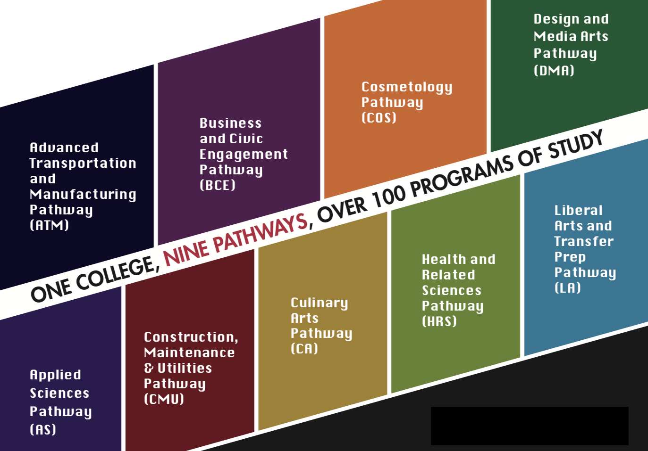
How does AB 705 impact Pathways?
We recommend the following:
Enhanced 101 course with a 2-unit corequisite contextualized for each pathway
Notes:
As most students will be eligible to enroll in English 101, our workgroup recommends contextualized 101 courses with concurrent support that can be taught to a student cohort within each pathway. Ideally, these courses will also include an embedded tutor. Book choices and readings can be tailored to reflect the pathway focus while still meeting SLOs. Additionally, contextualized 101 courses in pathways can involve collaboration with discipline content area specialists. (I believe this is what Lisa does with culinary)

Slide 8
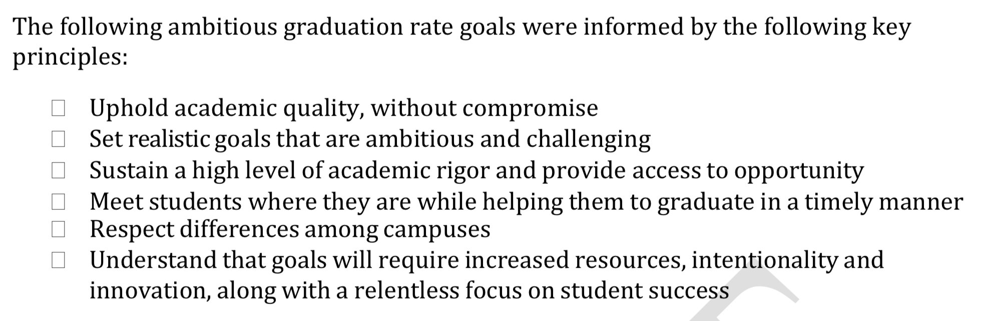
CSU’s Graduation Initiative
In 2009, The California State University (CSU) launched its first concerted graduation initiative (GI) to improve six-year completion rates and halve achievement gaps for first-time freshman by 2015. The results of the first phase exceeded original completion goals as CSU achieved the highest graduation rates in recent history. As a consequence, CSU committed to revisiting its goals during the summer of 2016.
The CSU’s implemented the Graduation Initiative to increase the number of students who complete a Baccalaureate degree by 40%--their goal is to attain this by the year 2025.
Notes:
We recognize that such transformative change can be scary for some, so it’s important to note that the CSUs have already implemented such change and that AB 705 actually allows us to catch up the CSUs.
The CSUs launched the Graduation Initiative to increase graduation rates by 40% by the year 2025.
“The CSU system recently eliminated remedial—or developmental education—perquisites in favor of more effective models...The CSU’s new policy, which also retools the methods used to gauge college readiness, instructs its 23 campuses to embed academic support into college-level courses for students who need additional academic support.”
“Students relegated to developmental education at the beginning of their college careers are far less likely to graduate—in some cases, upwards of 20 percent less—than those that enroll directly into college courses. Even students who do make it to graduation end up paying more and taking longer to earn their degrees. This has significant financial consequences and requires nearly one-third of our entering class to enter at a deficit.”
“The other significant impact that comes with assigning to students developmental education is that it invites them, perhaps unintentionally, to question whether they belong in college. Every year, the CSU accepts nearly 65,000 first-year students—one-third of which are the first in their family to attend college. Approximately 40 percent of entering students are identified as not ready for college coursework and directed to non-credit-bearing prerequisite courses with pre-college material. Students long remember the sinking feeling of when they are informed that they are accepted, but not quite ready to take college-level English or math. It is not uncommon for these students to drop out, given the alternative is to continue through a system that puts them in a deficit at the very beginning of their college careers.”
“ It is our obligation to remove any barriers that may hold students back due to their backgrounds or the circumstances from which they come. “
Source: https://evolllution.com/attracting-students/accessibility/moving-away-from-non-credit-developmental-education-to-support-student-retention-and-success/

